Slide 1
Lab set up
Download the basic-ml-model-deploy.zip file I have shared
Extract to a CWD, say d:\smlr\session6\flaskLab

Slide 2
Fit pipeline, model and pickle objects
Open in browser or VS code and execute all cells in Train_Deploy.ipynb
Observe in the same folder, feat_catv1, feat_numv1, and full_pipeline pickle files

Slide 3
Use pickle files in Test run
Open in browser or VS code and execute all cells in Test_Deploy.ipynb
Observe the train stage objects read in as pickle and used in this notebook
Note the output prediction

Slide 4
Execute Flask Web App
In a terminal (anaconda prompt or in VS code) activate a python env which has flask installed (else use pip install flask)
Navigate to the folder containing this lab files and execute:
python app.py
Flask app starts and available at localhost:5000
Access using a browser
See screenshot in the next slide after using the same feature values as in the Test run

Slide 5
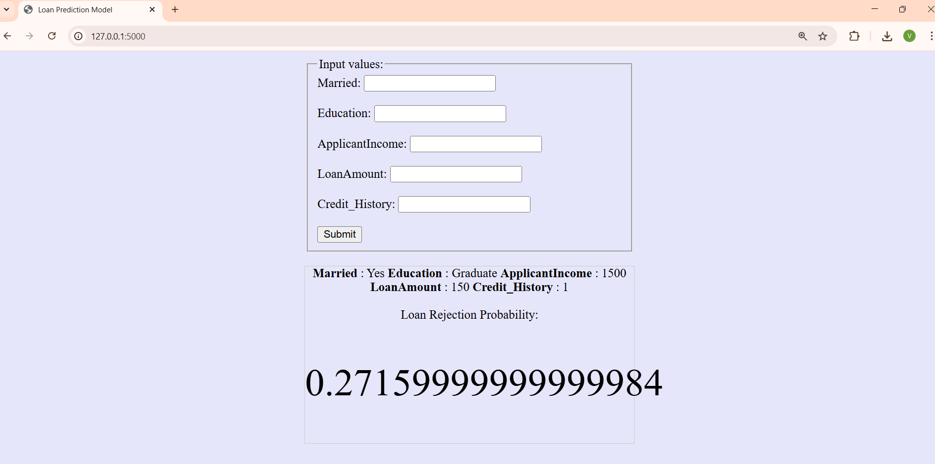

Slide 6
FAQ
In the Test run step, if you have not already run Train step, the pickle files will be missed
In the last step, if you use the app.py downloaded from Olympus there is a small issue as it does not handle data type. I have shared the fixed version.
In the last step, error if flask is not installed in your python env

